Slide 1





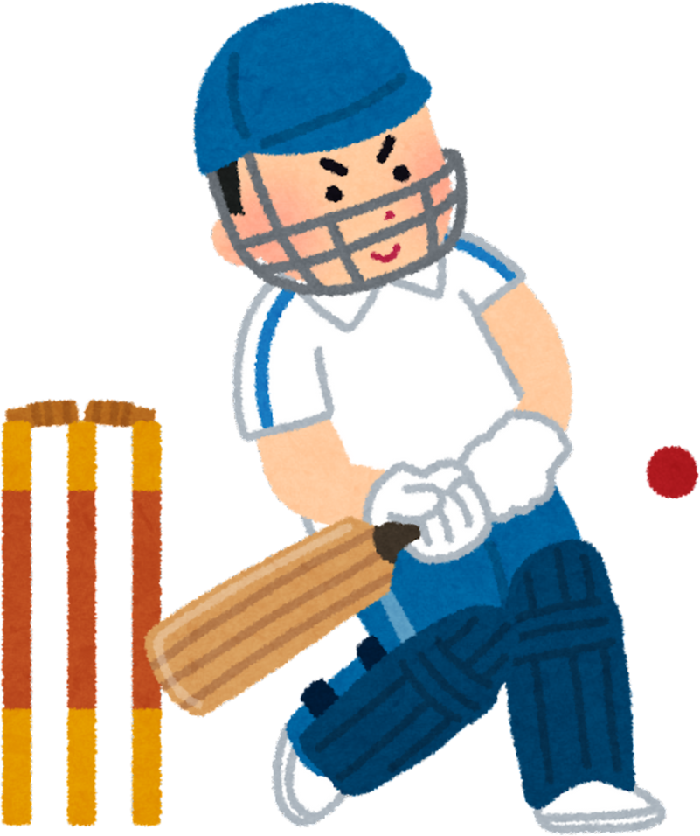
BRIGHT-TV
Presented By: Sboniso Jiyane

Slide 2






Data sample
9 provinces
2 genders with others
Time interval
Jan-mar(first quater)
Apr-Jun(second)
Jul-Sept(Third)
Oct-Dec(Forth)
Channels information
19 channels
Superport Live
ICC Cricket &
Channel O

Slide 3

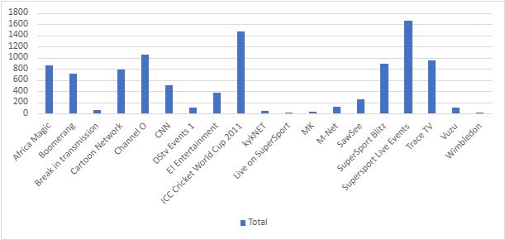
Number of people streaming
Live on SuperSport & ICC Cricket 2011 are most watched

Slide 4

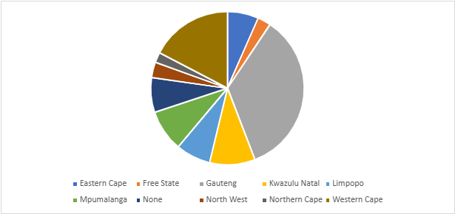
Provinces watching the channels
Gauteng is the province with most viewers followed by Western Cape

Slide 5
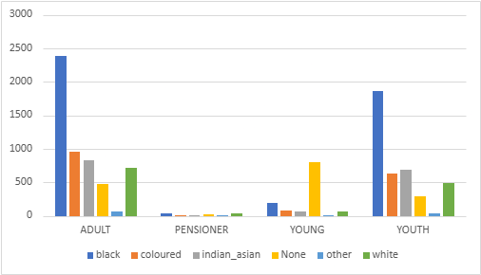

Viewers age and their race
Among all age groups blacks become the most viewers of Bright TV

Slide 6

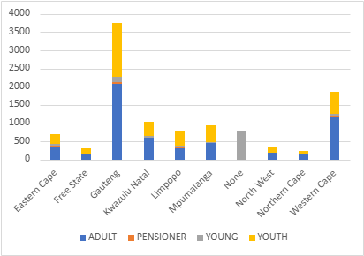
Viewership by province and age group
Adults from Gauteng are regular viewers along with youth

Slide 7
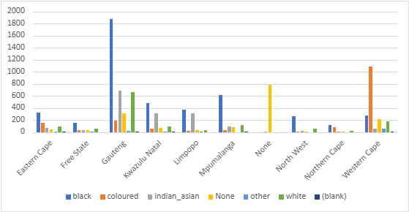
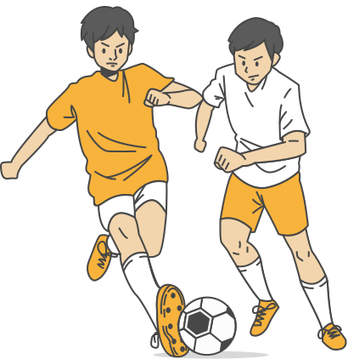
Races streaming in different provinces
Blacks in Gauteng & Coloured in Western Cape are regarded as most viewers

Slide 8
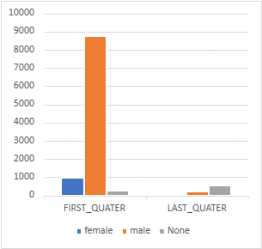

Viewers by gender on quaters
On first quater males view the most

Slide 9

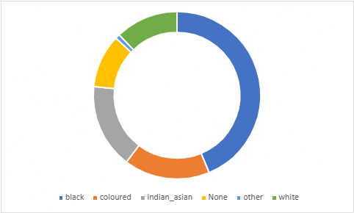


Races number of viewership

Slide 10


Conclusion
Gauteng and Western Cape has the most viewers and Northern Cape with the least number
High%
Gauteng
Northern Cape
Low%
Most viewers are Black and Coloured males Superport Live and ICC Cricket 2011 are most viewed
Bright TV must add channels that stream live matches and cricket

